Slide 1
Nature and objectives of women's education 3rd semester/paper code-303
By:-MRS.RINKI KUMARI
DEPTT.OF EDUCATION
MMHA&PU,PATNA

Slide 3
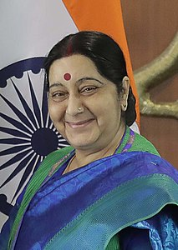
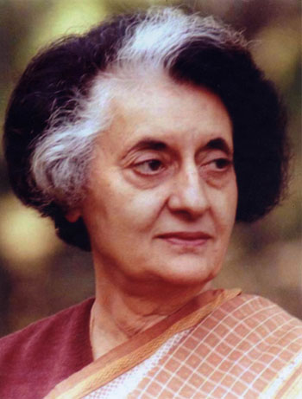
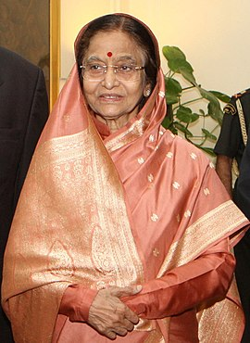
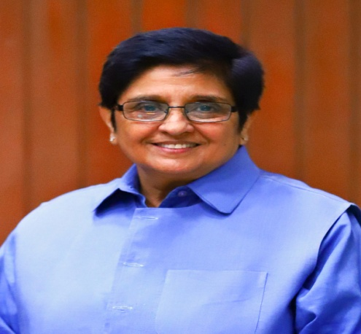
Some inspirations of women’s education

Slide 4
Nature/Characteristics of women
Sacrificing
Caring
Quiet
Sympathetic
Adjusting
Mostly, women are cooking, cleaning, washing etc…
Women have entire responsibility for child.

Slide 5
Objectives of women education
NCERT(1976) has stated the following women’s education in our society:-
Home management
Equal commitments
Equal opportunities
Decision making yf

Slide 6
Cont…
Legal rights ggggggggghghghgfffffff
Participation in public affairs gtttttrt
Developing achievement motivation
Self-dependence ggggggggggghghfffgggggg
Increasing productivity gggggggghggg

